Slide 1

WELCOME TO THE
SASSETA 2019 ROAD SHOW
Presented by (Research Department)
YOUR PARTNER IN SKILLS DEVELOPMENT

Slide 2
Contents
What is an OFO?
Purpose of the OFO
Key definitions
Structure of the OFO
OFO, Skills level and NQF levels
Who use the OFO?
Tips for using OFO
Conclusion
Questions and answers
YOUR PARTNER IN SKILLS DEVELOPMENT

Slide 3
What is OFO?
Organising Framework for Occupations (OFO) is a skill-based coded classification system, which encompasses all occupations in the South African context.
It is a key tool for identifying occupations in the SA labour market in terms of supply and demand needs (scarce and critical skills priorities) .
It informs the development of occupational qualifications.
YOUR PARTNER IN SKILLS DEVELOPMENT

Slide 4
Purpose of the OFO
  Provides a common language for making reference to occupations.
  Groups occupations according to similar tasks, skills and knowledge.
Provides a framework to analyse jobs and identify similar tasks and skills in order to map the jobs to appropriate occupations.
To enable the identification scarce, critical and PIVOTAL skills in the labour market.
Employers must use the OFO to report on scarce, critical and PIVOTAL skills when developing Annexure 2 (also known as Workplace Skills Plan or WSPs).
YOUR PARTNER IN SKILLS DEVELOPMENT

Slide 5
Key definitions…
A job
A set of tasks and duties carried out or meant to be carried out, by one person for a particular employer, including self-employment.
An occupation
A set of jobs whose main tasks are characterized by a high degree of similarity across a range of contexts with similar knowledge requirements.
  Occupations are informed by different sets of skills.
YOUR PARTNER IN SKILLS DEVELOPMENT

Slide 6
Key definitions
  Skill
  Ability to carry out the tasks and duties of a given job.
  It is measured in terms of
      complexity and range of work;
      level of formal education required for competent performance; and
      amount of informal on-the-job training/previous experience.
Could include skill specialisations, which is based on
    The field of knowledge required
    Tools required
    Materials worked on or with; and
    Kinds of goods and services produced.
YOUR PARTNER IN SKILLS DEVELOPMENT

Slide 7
The structure of the OFO
  2017-1 Managers,
  2017-2 Professionals,
  2017-3 Technicians and associate professionals,
  2017-4 Clerical support workers,
  2017-5 Services and sales workers,
  2017-6 Skilled agriculture, forestry, fisheries, craft and related trades workers,
  2017-7 Plant and Machine Operators and Assemblers, and
  2017-8 Elementary occupations.
YOUR PARTNER IN SKILLS DEVELOPMENT

Slide 8
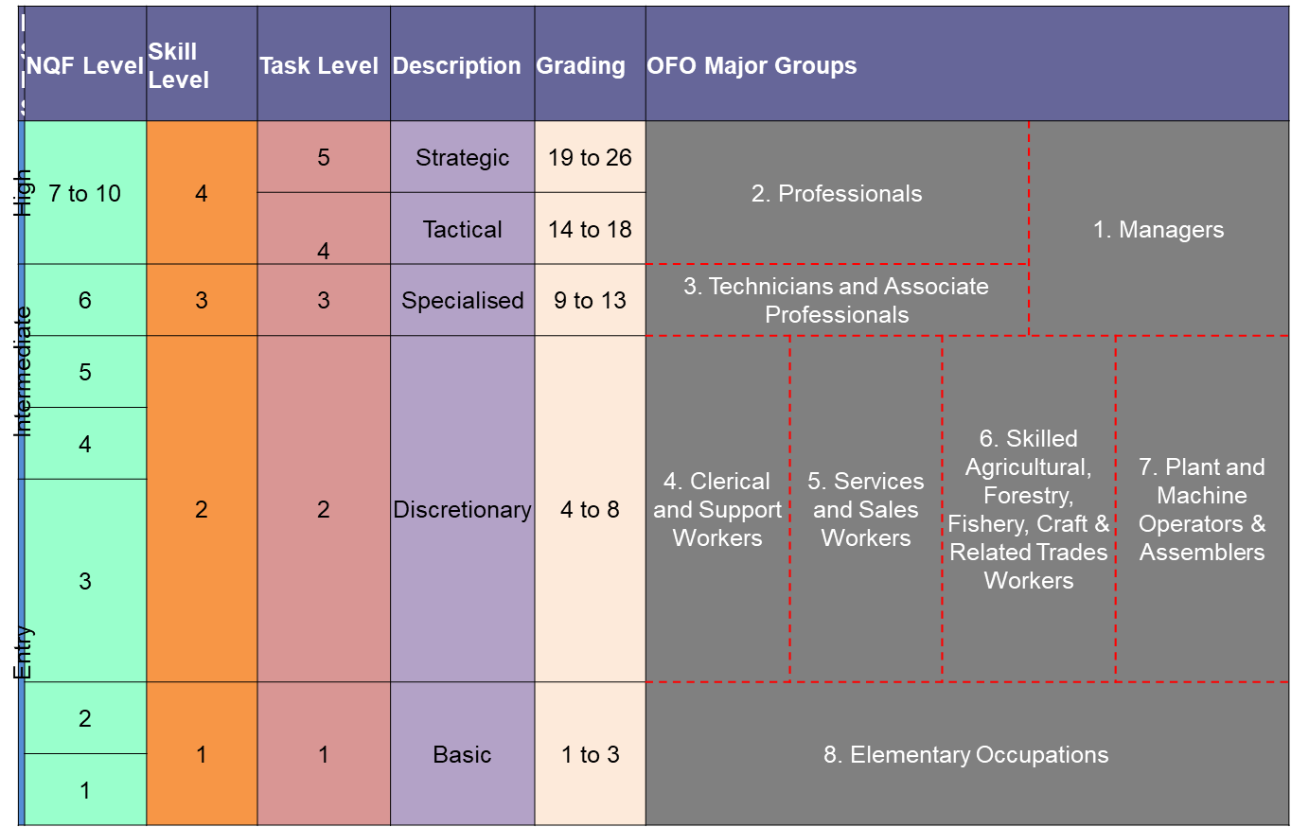
OFO, Skills levels and NQF levels

Slide 9
Example
Generic Job Title | Job Purpose / Output | OFO Descriptor | OFO Occupation | OFO Code
Police Officer | Maintains public order, enforce laws and patrolling public areas | Maintains public order, and enforces laws by investigating crimes, patrolling public areas and arresting offenders. | Constable (SAPS) | 2017-541202
Lawyer | Provide legal advice and provide legal documents | Provide legal advice, prepares and drafts legal documents and conducts negotiations on behalf of clients on matters associated with the law. | Attorney | 2017-261101
YOUR PARTNER IN SKILLS DEVELOPMENT

Slide 10
Example …
Example: Same generic job title - different occupations and codes
Generic Job Title | Job Purpose / Output | OFO Descriptor | OFO Occupation | OFO Code
Business Analyst | To develop strategic financial analyses to enhance business planning and revenue and or income | Develops and implements financial plans for individuals and organisations. Advises on investment strategies and their taxation implications, securities, insurance, pension plans and real estate. | Financial Investment Advisor | 2017-241301
Business Analyst | To analyse and develop ICT system requirements to enable and enhance organisational performance | Evaluates processes and methods used in existing ICT systems. Proposes modifications, additional system components or new systems to meet user needs as expressed in specifications and other documentation. | ICT Systems Analyst | 2017-251101
30
YOUR PARTNER IN SKILLS DEVELOPMENT

Slide 11
Who uses the OFO?
SETAs are compelled to use it in the SSP to reflect sector skills needs (occupations where employees are required).
Employers use the OFO on Annexure 2 (WSPs/ATRs).
Quality Council for Trades and Occupations (QCTO) for developing occupational qualification and certification.
NAMB (National Artisan Managing Body) for implementation of listed trades.
YOUR PARTNER IN SKILLS DEVELOPMENT

Slide 12
Tips for using the OFO
Start at the top of the OFO major group to determine which of the
major group descriptors best represent the stated descriptor.
Then determine which of the sub-major group, minor group,
unit group best represent the descriptor.
Find the most suitable six digits occupation
YOUR PARTNER IN SKILLS DEVELOPMENT

Slide 13
Conclusion
OFO code advance appropriate and coherent Skills Planning as
well as Occupational Qualification Development.
Link key job titles to occupation.
Remove indicators of seniority e.g. chief, senior, junior, etc.
OFO codes are continuously updated in response to technical
advances and changing business practices – new occupations.
YOUR PARTNER IN SKILLS DEVELOPMENT

Slide 14

QUESTIONS ?
YOUR PARTNER IN SKILLS DEVELOPMENT

Slide 15
Thank you! ☺
Switch board: 011 087 5500
Call Centre: 011 087 5555
Follow us on Facebook
www.sasseta.org.za
YOUR PARTNER IN SKILLS DEVELOPMENT

