Slide 1

SECTOR SKILLS PLAN
2018 UPDATE
2019 ROADSHOWS
12 February – 14 March 2019
Ramolobi Matlala
Research & Skills Planning Manager

Slide 2

Contents
1. Introduction
2. The structure of the SSP
3. Synopsis of the 2018 SSP
4. Conclusion
YOUR PARTNER IN SKILLS DEVELOPMENT

Slide 3

Introduction
SASSETA (or any other SETA) is enjoined by section 10 (1)(a) of the Skills Development Act (Act 97 of 1998) to develop a sector skills plan (SSP) within the framework of the national skills development strategy.
The purpose of the SSP is to guide the strategic direction of the SETA.
The structure of the SSP is prescribed by the DHET through the SSP framework.
YOUR PARTNER IN SKILLS DEVELOPMENT

Slide 4
Structure of the SSP
Chapter One:
Sector Profile
Chapter Two:
Key Skills Issues
Chapter Three: Skills Shortages and Gaps
Chapter Four:
Sector
Partnerships
Chapter Five:
Skills Priority Actions
YOUR PARTNER IN SKILLS DEVELOPMENT

Slide 5
Structure of the SSP
Chapter 2: Key Skills Issues
What are the major factors impacting on skills demand and supply in the sector?
How do these change drivers impact on skills demand and planning in the sector?
Chapter 1: Sector Profile
What is the sector’s contribution to the economy?
How does this compare to the rest of the economy?
How is the sector performing?
How competitive is the sector?
Future outlook?
Inputs required per Chapter
YOUR PARTNER IN SKILLS DEVELOPMENT

Slide 6
Structure of the SSP
Chapter 3:
Skills Shortages and Gaps
- Which occupations have vacancies?, or hard to fill?
- Wage and employment trends?
- Conditions of employment
- How is migration impacting on the sector?
- Update on the scare & critical skills and the state of education in the sector.
Chapter 5:
Sector Skills Priority Actions
- What are the skills priorities
for the sector?
Chapter 4:
Sector Partnerships
- What should be done to strengthen partnerships to advance skills development in the sector?
Inputs required per Chapter
YOUR PARTNER IN SKILLS DEVELOPMENT

Slide 7
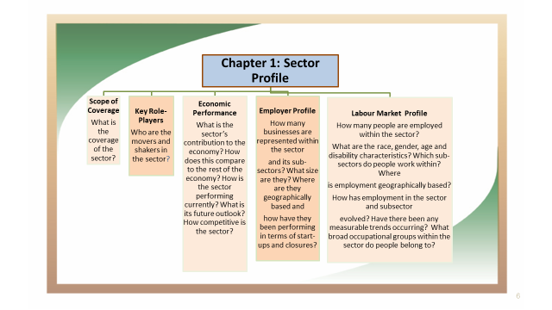
Structure of the SSP

Slide 8
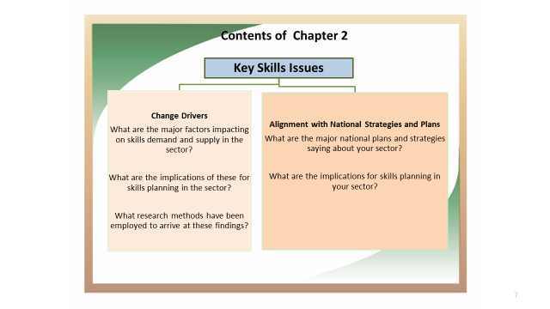
Structure of the SSP

Slide 9
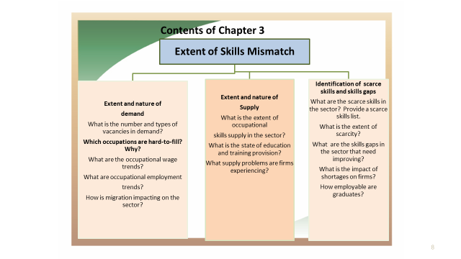
Structure of the SSP

Slide 10
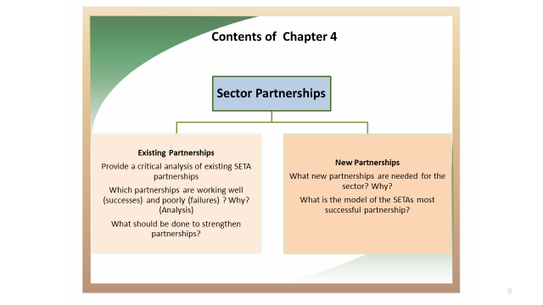
Structure of the SSP ...
YOUR PARTNER IN SKILLS DEVELOPMENT

Slide 11
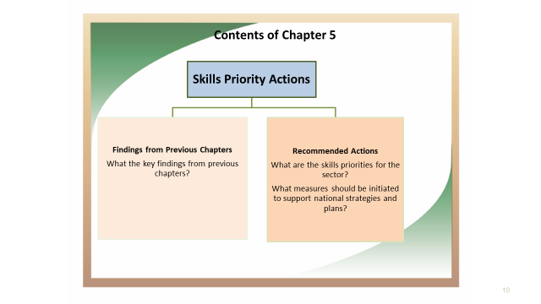
Structure of the SSP ...
YOUR PARTNER IN SKILLS DEVELOPMENT

Slide 12
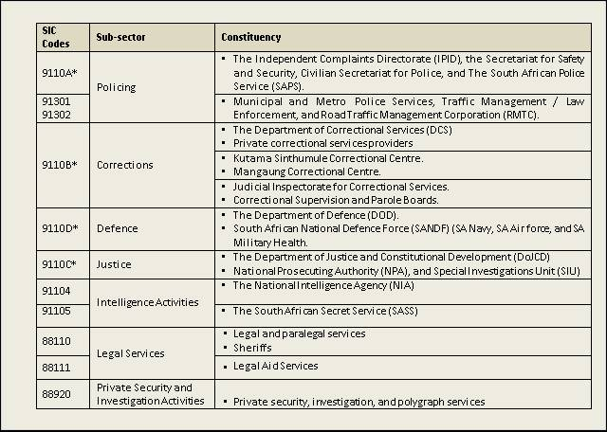
Chapter 1:
Sector Profile
Scope of coverage
YOUR PARTNER IN SKILLS DEVELOPMENT

Slide 13
Chapter 1: Sector Profile…
The sector profile has been developed by considering data in respect of, among others:
Economic contribution,
Total employment, and
Distribution of employment by province and occupational group, population group, gender, age and disability status, among others.
YOUR PARTNER IN SKILLS DEVELOPMENT

Slide 14
Chapter 1: Sector Profile…
Number of active employers per subsector
Subsectors | Levy Paying Organisations | Government Departments
Defence | 1 | 1
Corrections | 4 | 1
Justice | 1 | 1
Legal Services | 2 058 | -
Policing (RTMC) | 1 | 1
Private Security and Investigation Activities | 1 292
Total | 3 355 | 4
Subsector | 2011/12 | 2012/13 | 2013/14 | 2014/15 | 2015/16 | 2016/17 | 2017/ 18
 | Number of organisations
Legal Services | 1 655 | 1 735 | 1 751 | 1 772 | 1752 | 1688 | 2 058
Private Security and Investigation Activities | 982 | 975 | 966 | 991 | 960 | 971 | 1 292
YOUR PARTNER IN SKILLS DEVELOPMENT

Slide 15
Chapter 1: Sector Profile…
The majority of employees (70%) are Service and Sales Workers, while Clerks (9%) are the 2nd largest category, followed by Technicians and Associate Professionals (6%).
Categories of Professionals, and Legislators, Senior Officials and Managers respectively constitute 5% and 4% of total employment.
The sector is generally dominated by male employees (70%).
YOUR PARTNER IN SKILLS DEVELOPMENT

Slide 16
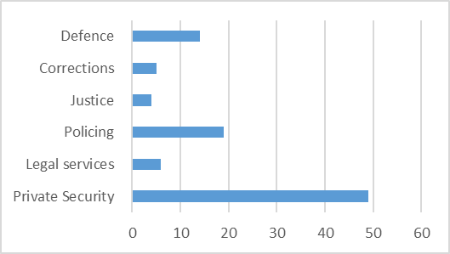
Chapter 1: Sector Profile…
Total employment per subsector(%)
YOUR PARTNER IN SKILLS DEVELOPMENT

Slide 17
Chapter 1: Sector Profile…
Organisations per size
YOUR PARTNER IN SKILLS DEVELOPMENT

Slide 18
Chapter 1: Sector Profile…
Employment by province Racial composition of the sector
YOUR PARTNER IN SKILLS DEVELOPMENT

Slide 19
Chapter 1: Sector Profile…
Racial composition per subsector
YOUR PARTNER IN SKILLS DEVELOPMENT

Slide 20
Chapter 2:
Key skills Issues in the Safety and Security Sector…
Change drivers in the sector
The research suggests that factors such as globalisation and technological advancements are changing the patterns of crime, which impact on safety and security in South Africa.
This compels role players in the criminal justice system and the broader safety and security sector to re-define their focus to address the changing face of crime and re-aligning their objectives to serve national imperatives.
Other change drivers include population growth, unemployment, poverty, gender-based and domestic violence and, the generally growing rate of crime as well as the changing nature of crime all have skills planning implications in the sector.
YOUR PARTNER IN SKILLS DEVELOPMENT

Slide 21
Chapter 2:
Key Skills Issues in the Safety and Security Sector
Alignment with National strategies and Plans
Consideration was given to the changes in national legislation. policies and strategies during the development of the SSP.
This approach to crafting the SSP an essential because skills development initiatives are embedded in legislation and public policy.
YOUR PARTNER IN SKILLS DEVELOPMENT

Slide 22
Chapter 3:
Occupational Shortages and Skills Gaps
Hard-to-fill-Vacancies per Occupation
 | Hard-To-Fill Vacancies Per Occupation | OFO Code | Reason(s)
1 | Security Guard | 2017-5414 | Lack of skills Lack of experience Lack of and knowledge
2 | Counselling psychologist | 2017-263407 | Lack of skills Lack of experience
3 | Plumbers | 2017-642601 | Lack of experience
4 | Artisans Aide Building Trade | 2017-831301 | Lack of experience
5 | Human Resource | 2017-441601 | Lack of experience
6 | Labour Relations | 2017-441604 | Lack of experience
7 | Technicians (Alarms Installations) | 2017-3 | Lack of skills and expertise
8 | Facilitator | 2017-235101 | It’s not easy to find the right candidates
9 | Attorney | 2017-261101 | It is difficult to find qualified people with skills to the job
YOUR PARTNER IN SKILLS DEVELOPMENT

Slide 23
Chapter 3:
Occupational Shortages and Skills Gaps
Table 2018 SETA PIVOTAL LIST | No | OFO Code | Occupation | Specialisation | NQF | Intervention
 | 1 | 2017-541402 | Alarms, Security or Surveillance Monitor | Alarms and Surveillance Monitoring | 4 | Alarms, Security or Surveillance Monitor (Learnership)
 | 2 | 2017-241104 | Forensic Auditor/ Investigator | - | 6 | Certificate cybercrime investigation
 | 3 | 2017-261101 | Attorney | Bookkeeping | 5 | Apply accounting skills in an attorney's books of account (Skills Programme). This is a unit standard under National Certificate: Attorneys Practice.
 | 4 | 2017-263507 | Social Worker | Forensic/Health Care/Clinical Social Worker | 5 6 7 8 | Certificate Forensic Examinations Higher Cert in Forensic Examinations Diploma: Criminal Justice & Forensic Auditing Diploma: Forensic Nursing Forensic Investigations Bachelor of Art in Forensic Science & Technology
 | 5 | 2017-652203 | Locksmith | Locksmith (Key Cutter) | 4 | Learnership
YOUR PARTNER IN SKILLS DEVELOPMENT

Slide 24
Chapter 3
Occupational Shortages and Skills Gaps
New and emerging occupations
Cybercrime specialist ;Crime analysts; Private investigators,
Client experience experts; Access Control technicians; Psychologists.
Broad Occupational Levels | The Three Most Common Skills Gaps per Broad Occupational Levels
Senior Level (Managers and Professionals) | Leadership and management skills (including planning, project management and marketing skills)
 | Communication skills
 | Computer literacy
Mid-level (Technicians, Artisans, Clerical) | Computer literacy
 | Communication skills
 | Work ethic
Lower-level (Plant Operators and Elementary) | Qualifications
 | Skills (entry level)
 | Basic computer literacy
YOUR PARTNER IN SKILLS DEVELOPMENT

Slide 25
Chapter 3
Occupational Shortages and Skills Gaps
New and emerging top up skills
Technical skills
Management (and leadership) skills
Marketing skills,
Investigation skills
Team building skills
YOUR PARTNER IN SKILLS DEVELOPMENT

Slide 26
Chapter 3
Occupational Shortages and Skills Gaps
PIVOTAL List – Top Ten
OFO Code | Occupation (Scare Skills) | Specialisation / Alternative Title | Intervention Planned by the SETA
2017-541401 | Security Guard | - | Learnership (Bursary)
2017-222108 | Registered Nurse (Medical) | Professional Nurse (Primary Health Care) | National Certificate / Diploma (Bursary)
2017-235101 | Education or Training Advisor | - | Executive Management Development Programme
2017-541402 | Alarms, Security or Surveillance Monitor | - | Firearm Competency Training
2017-226201 | Hospital Pharmacist | Clinical Pharmacist & Health Service Pharmacist | Bursary (Degree)
2017-263403 | Organisational Psychologist | - | Advanced Level Psychology /Degree/Bursary
2017-143904 | Security Services Manager | - | Diploma/Degree ( Bursary)
2017-311301 | Electrical Engineering Technician | - | Degree ( Bursary)
2017-351101 | Computer Operator | - | Diploma
2017-541201 | Traffic Officer | Law Enforcement Officer | Learnership
YOUR PARTNER IN SKILLS DEVELOPMENT

Slide 27
Chapter 3
Occupational Shortages and Skills Gaps
SASSETA Intervention | No. of Projects
 | 2016/17 | 2017/18
Adult Education and Training | 1 | -
Artisan Development (various interventions) | 19 | 12
Bursaries: Employed | 14 | 37
Internships | 05 | 17
WIL Internships | - | 7
Learnerships: Employed (Various interventions) | 35 | 99
Learnerships: Unemployed | 61 | 82
Skills programmes: Unemployed (Various interventions) | 25 | 48
Skills programmes: Employed (Various interventions) | 50 | 92
TVET Graduate Placement | 7 | 9
WIL-TVET Graduate Placement (Various interventions) | 3 | 4
University Placements | 1 | 24
Internship Candidate Attorney | 10 | 4
WIL-University Graduate (Candidate Attorneys) | 3 | -
NGO Skills programmes | 1 | -
Non-PIVOTAL: TVET Placement | 1 | -
TOTAL | 234 | 435
YOUR PARTNER IN SKILLS DEVELOPMENT

Slide 28
Chapter 3
Occupational Shortages and Skills Gaps
YOUR PARTNER IN SKILLS DEVELOPMENT

Slide 29
Chapter 4
Sector Partnerships
In recognition of the broad mandate of each SETA in skills development, and in order to better meet its strategic objectives, it becomes a critical part of the service delivery model to form partnerships with other entities within and across its sector of operation.
SASSETA has established partnerships with Universities, Technical and Vocational Education and Training Colleges (TVET Colleges) and other strategic partners who it anticipates can positively impact on its service delivery.
SASSETA’s model of partnerships is predominance of MoU formations. However, a new way of looking at partnership structures needs to be considered.
Partnership coordination, monitoring and evaluation mechanisms must be strengthened to ensure delivery on targets and objectives.
YOUR PARTNER IN SKILLS DEVELOPMENT

Slide 30
Chapter 5
Sector Skills Priority Actions
SASSETA has identified five skills priority actions, namely:
Strengthening partnership with sector training institutions and academy.
Professionalisation and transformation of the sector.
Information communication and technology (ICT).
Technical and specialised skills
Building active citizenry.
YOUR PARTNER IN SKILLS DEVELOPMENT

Slide 31
Conclusion
Skills development should be differentiated (rather than be a one size fits all) according to the business settings.
There is growing recognition that the industries are undergoing fundamental changes as a result of the technological disruptions, which are affecting the nature of work and occupational skills and society.
Education, training and skills development to thrive needs institutional context and certainty policy frameworks.
YOUR PARTNER IN SKILLS DEVELOPMENT

Slide 32
THANK YOU

